Slide 1



RAJIV GANDHI INSTITUTE OF TECHNOLOGY
Department of Computer Science and Engineering
TECHNICAL SEMINAR
Green Cloud Computing
Under the Guidance of:
Mrs. Kavyashree J
Assistant Professor,
Dept. of CSE, RGIT.
Presented By:
Santhosh P (1RG20CS050)

Slide 2

CONTENTS
Abstract
Introduction
Need for Green Cloud Computing
Techniques for Achieving Green Cloud Computing
Case Studies of Successful Green Cloud Computing Implementations
Challenges and Considerations in Adopting Green Cloud Computing
Conclusion
References

Slide 3


Abstract
Cloud computing has transformed global access to processing power, but its reliance on massive data centers raises environmental concerns due to high energy consumption and CO2 emissions. Green Cloud Computing addresses this by using recycled energy and eco-friendly practices to reduce environmental impact. It explores the rationale behind adopting Green Cloud, emphasizing sustainability and resource efficiency. Key research areas such as power management, virtualization, and green data centers are discussed to create environmentally responsible cloud solutions. The goal is to maintain quality service for users while achieving energy efficiency and minimizing environmental harm, focusing on energy consumption measurement and prediction for future sustainability.

Slide 4

Introduction
Cloud Computing Basics: Cloud computing utilizes internet-based resources for computing needs, offering scalability and flexibility. Virtualization enables computing on virtual servers, enhancing cost-efficiency and resource allocation.
Types of Cloud Services: Cloud providers offer IaaS, PaaS, and SaaS, catering to diverse needs and functionalities for businesses and individuals.
Green cloud computing: Green Cloud Computing refers to the environmentally friendly usage of cloud computing resources. By utilizing renewable energy sources and efficient infrastructure, it aims to minimize carbon footprint and energy consumption.
Transition to Green Cloud Computing: Green Cloud Computing focuses on energy-efficient practices and sustainability, employing techniques like virtualization and renewable energy adoption.
Goals and Techniques of Green Cloud Computing: Green Cloud Computing aims to reduce hazardous chemical usage, improve energy efficiency, and promote recyclable disposal. Strategies include nano data centers and Dynamic Voltage and Frequency Scaling (DVFS).
g

Slide 5
Need for Green Cloud Computing
Reduced Carbon Footprint
Cost Savings
Green cloud computing minimizes environmental impact by reducing carbon emissions.
Businesses save on energy costs and can access cost-effective cloud services.
Sustainability
Efficiency and Scalability
It promotes the use of renewable energy sources, contributing to long-term sustainability.
Cloud services enable efficient resource utilization and scalable infrastructure.

Slide 6
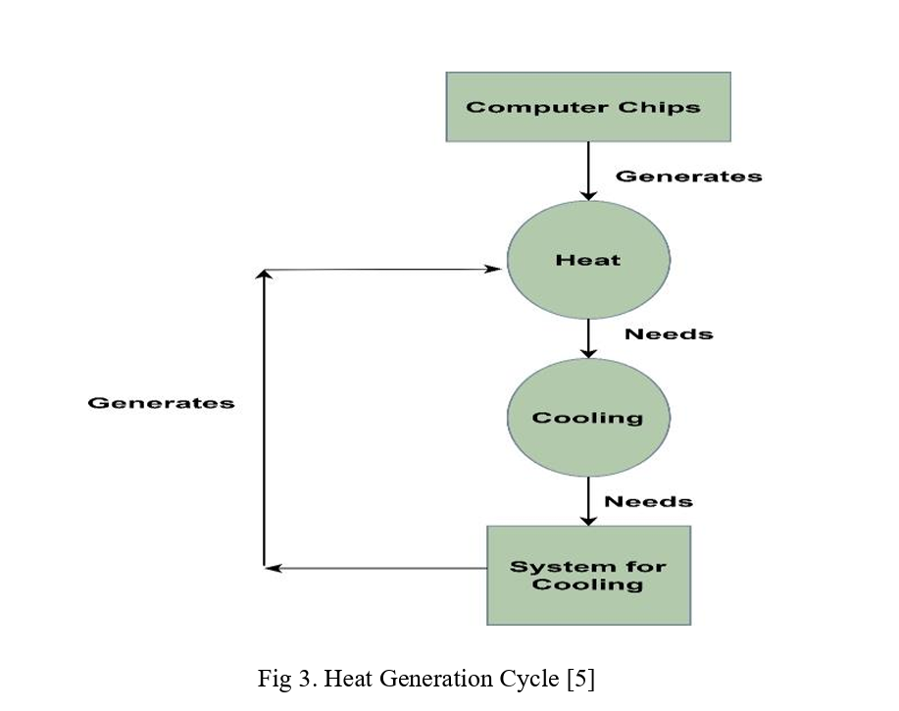
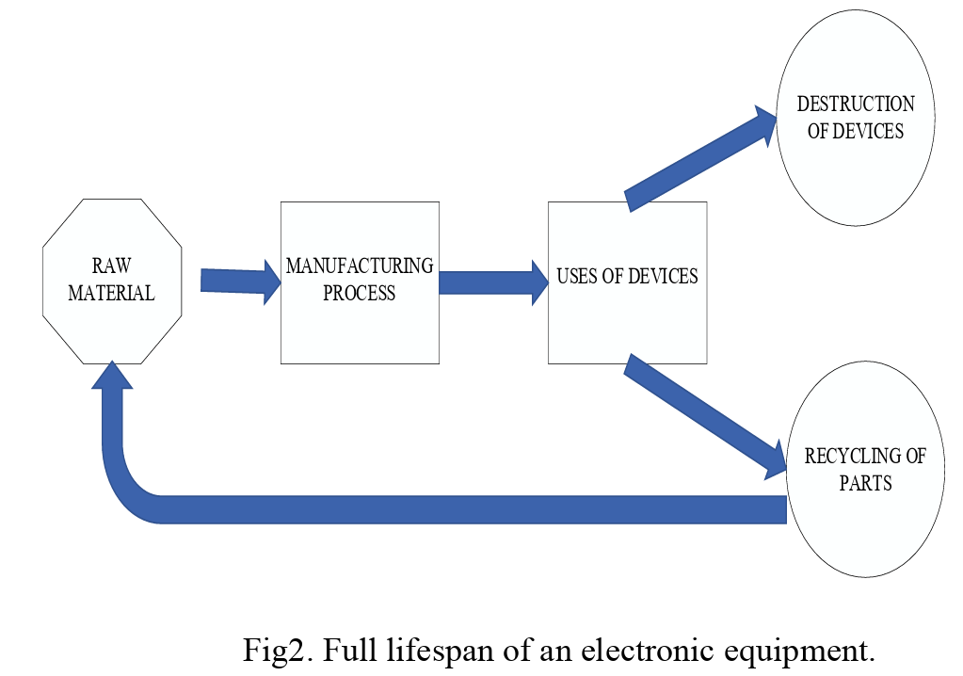
Environmental Impact of Computing Devices
Sustainable practices are crucial to minimize the environmental impact of computing devices, including responsible e-waste management
Energy Consumption in Data Centers
Green computing advocates for reducing energy use in data centers through efficient systems and virtualization technologies
Lifecycle Impact of Electronic Equipment
Managing the lifecycle of electronic equipment requires responsible e-waste recycling and sustainable technologies.
Sustainable Practices and Solutions
Green computing promotes energy conservation, CO2 reduction, and responsible e-waste disposal for a greener computing ecosystem

Slide 7
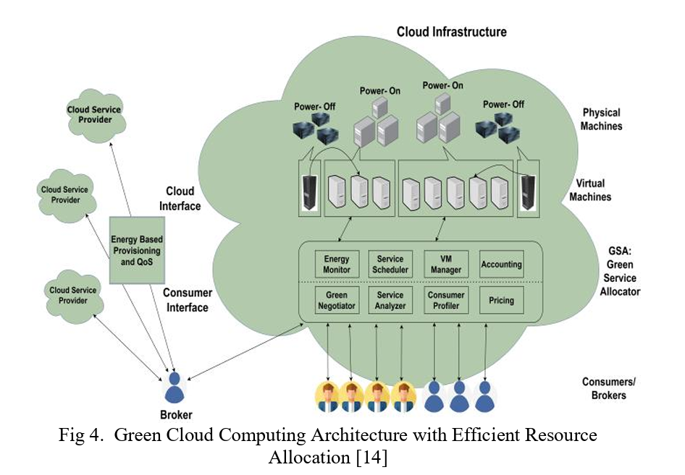
Techniques for Green Cloud Computing
The architecture emphasizes sustainability and energy efficiency with renewable energy for cloud services and virtual machines for applications, ensuring cost savings and data security.
Green Service Allocator: An intelligent algorithm in green cloud computing that efficiently allocates resources, reducing energy usage.
Cloud Service Provider: Green Cloud Technologies offers a green cloud architecture with advanced analytics for energy reduction and performance improvement.
Automated Energy Monitoring: Sensors monitor energy usage accurately but can be costly due to hardware, software, and service expenses.
g

Slide 8

Energy-efficient Data Centers
Improved Data Center Cooling Techniques: Relocate servers closer to cooling systems to focus cold air and reduce energy losses. Utilize water-based air conditioning units for efficient cooling.
Nano Data Centers: Small-scale distributed data centers deployed near data sources or applications. Offer advantages like reduced latency, improved security, and cost-effectiveness due to lower power and cooling needs.
Design Principles of Energy-Efficient Data Centers: Incorporate energy-efficient cooling techniques, server virtualization, and renewable energy integration. Emphasize data center optimization for reduced energy consumption and operational costs.
Benefits of Energy-Efficient Data Centers: Modern and sustainable design principles. Cutting-edge technology and renewable energy use. Minimized environmental impact with reduced energy consumption and carbon footprint.

Slide 9
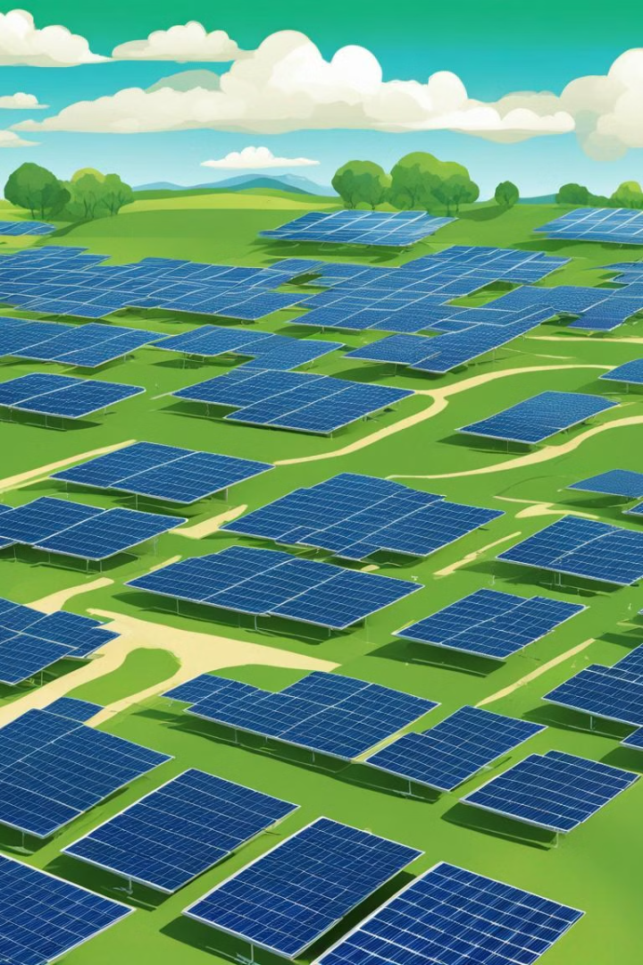
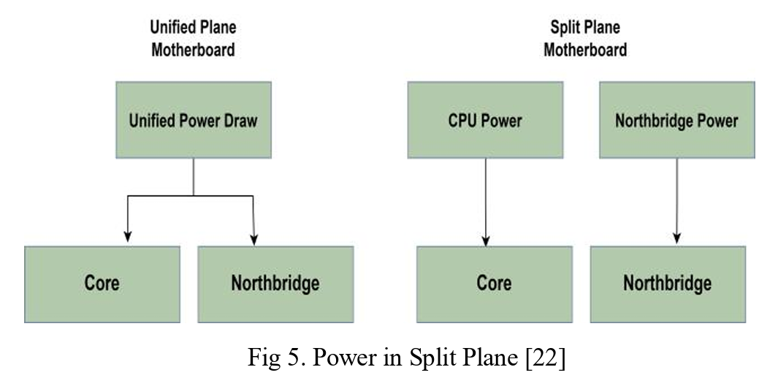
Renewable Energy Sources for Cloud Computing
Renewable Energy :
Solar Energy: Harnesses sunlight via panels for clean and abundant power.
Wind Energy: Utilizes turbines in wind farms for sustainable electricity generation.
Hydroelectric Power: Leverages water resources for renewable energy in data centres.
Energy Management Techniques:
Static Architecture Energy Management (SAEM): Focuses on low-power components.
Dynamic Architecture Energy Management (DAEM): Optimizes resource allocation in real-time.
Optimizing Power Consumption
Split Plane Power: Divides power distribution for optimized electricity usage.
Advanced Clock Gating: Controls logic block clocks for reduced power consumption.
Energy-Efficient Processors: Utilizes dynamic scaling for minimal power usage.

Slide 10

Virtualization and Resource Optimization
Virtualization and Resource Optimization:
Virtualization techniques consolidate servers, reducing energy use and carbon footprint.
Resource optimization ensures efficient resource utilization, minimizing waste and maximizing performance.
Virtualization enables the encapsulation of computer assets, reducing hardware and lowering power and cooling use.
Eco-Friendly Capacity:
Green computing strategies include virtualization of servers and efficient cooling systems.
VM consolidation, server virtualization, and DVFS are popular methods for improving data center energy efficiency.
Server virtualization reduces energy consumption, contributing to a greener cloud infrastructure.

Slide 11




Green Cloud Computing Initiatives
Eco-friendly Practices
Community Engagement
Global Initiatives
Tree Planting Initiatives
Implementing sustainable strategies for reduced environmental impact.
Initiatives that involve local communities in green cloud computing efforts.
Participating in worldwide programs for promoting eco-friendly cloud computing.
Supporting reforestation projects as part of green cloud commitments.

Slide 12
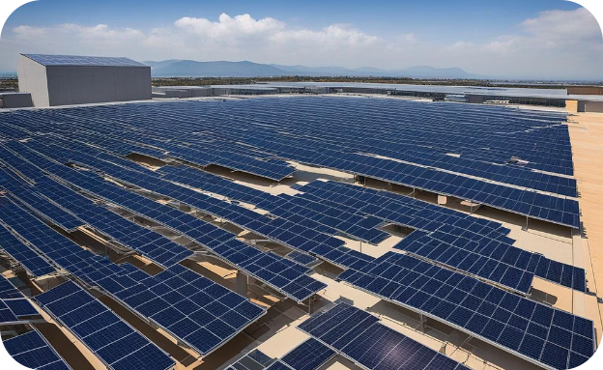
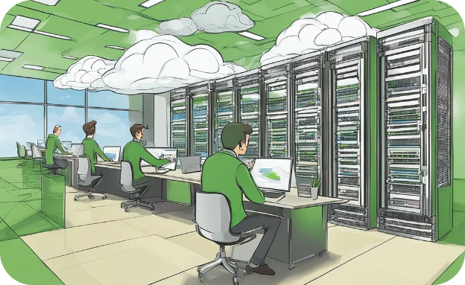
Case studies of successful green cloud computing implementations
Solar-Powered Data Center
Energy-Efficient Server Configuration
A data center powered by solar energy, showcasing a sustainable and environmentally friendly approach.
IT professionals working together to optimize cloud servers for energy efficiency and reduced carbon footprint.

Slide 13
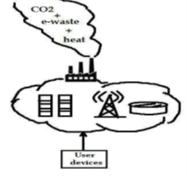
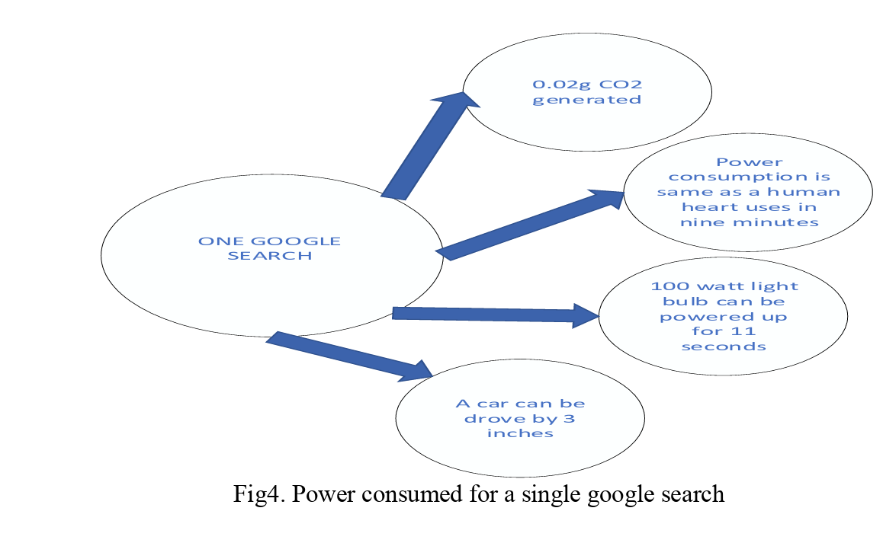
Google's Data Center Efficiency Projects
Advanced Cooling Technologies: Google implements innovative cooling solutions like liquid cooling and AI-driven temperature management to reduce energy consumption and improve efficiency.
Renewable Energy Investments: Google invests heavily in renewable energy sources such as solar and wind power, with a goal to power its data centers with 100% renewable energy.
Amazon Web Services' Renewable Energy Commitment
100% Renewable Energy Usage: AWS is committed to powering its global infrastructure with 100% renewable energy, investing in solar and wind projects worldwide.
Amazon Web Services has implemented Green Cloud Computing by using renewable energy sources, such as wind and solar power, to power their data centers. This has resulted in a 50% reduction in carbon emissions and a 30% reduction in energy consumption.
Microsoft‘s Azure
Microsoft has implemented Green Cloud Computing by using energy-efficient hardware and software, as well as using renewable energy sources to power their data centers. This has resulted in a 20% reduction in energy consumption and a 15% reduction in carbon emissions.

Slide 14
Challenges and Considerations in Adopting Green Cloud Computing
Initial Setup Costs
Data Security Concerns
Data Privacy
Performance and Scalability
Transitioning to green cloud computing may require significant initial investments in eco-friendly infrastructure and technologies.
Companies face challenges in ensuring the same level of data security and compliance while migrating to green cloud solutions.
Ensuring the security and privacy of data stored and processed in green cloud environments is a critical concern.
Maintaining high performance and scalability while optimizing resource usage in green cloud environments requires careful planning.
Organizations need to carefully assess the costs and benefits to ensure a smooth transition.
Addressing potential vulnerabilities and risks is crucial in the adoption process.
Robust security measures and compliance with data protection regulations are essential.
Balancing efficiency with peak performance is a key consideration for sustainable cloud operations.

Slide 15
Conclusion
Green cloud computing is a sustainable and efficient IT approach, reducing energy consumption and carbon emissions. Embracing it contributes to combating climate change and offers cost savings and improved performance. The rise of green cloud computing necessitates efficient energy solutions, like server virtualization, to enhance energy efficiency. Techniques such as incorporating low-power CPUs and power-scalable subsystems play a vital role. Metrics and methods for assessing power efficiency and reducing power requirements are crucial. Cloud computing's widespread adoption requires power-saving strategies to mitigate environmental impact and boost system efficiency.

Slide 16
References
[1] M. Wei Deng; Fangming Liu; Hai Jin; Bo Li; Dan Li, "Harnessing renewable energy in cloud datacenters: opportunities and challenges," Network, IEEE , vol.28, no.1, January-February 2014, pp.48,55.
[2] Negru, C.; Pop, F.; Cristea, V.; Bessisy, N.; Jing Li, "Energy Efficient Cloud Storage Service: Key Issues and Challenges,"2013 Fourth International Conference on Emerging Intelligent Data and Web Technologies (EIDWT), 9-11 Sept. 2013, pp.763-766.
[3] A. Ahmad, S. U. Khan, H. U. Khan, G. M. Khan, and M. Ilyas, “Challenges and Practices Identification via a Systematic Literature Review in the Adoption of Green Cloud Computing: Client’s Side Approach,” IEEE Access, vol. 9, pp. 81828–81840, 2021..
[4] N. Hu, Z. Tian, X. Du, N. Guizani, and Z. Zhu, “Deep-Green: A Dispersed Energy-Efficiency Computing Paradigm for Green Industrial IoT,” IEEE Transactions on Green Communications and Networking, vol. 5, no. 2, pp. 750–764, Jun. 2021.
[5] A. Ahmad, S. U. Khan, H. U. Khan, G. M. Khan, and M. Ilyas, “Challenges and Practices Identification via a Systematic Literature Review in the Adoption of Green Cloud Computing: Client’s Side Approach,” IEEE Access, vol. 9, pp. 81828–81840, 2021.

Slide 17


Slide 18


